Slide 1
SOAPSTone
SOAPSTone

Slide 2
SOAPSTone
SOAPSTone
A mnemonic device that provides an attack strategy for reading and analyzing nonfiction

Slide 3
SOAPSTONE
S=Speaker
O=Occasion
A=Audience
P=Purpose
S=Subject
T=Tone

Slide 4
PRACTICE
View the ad,
and I’ll walk us through
our first model of
SOAPSTone

Slide 5
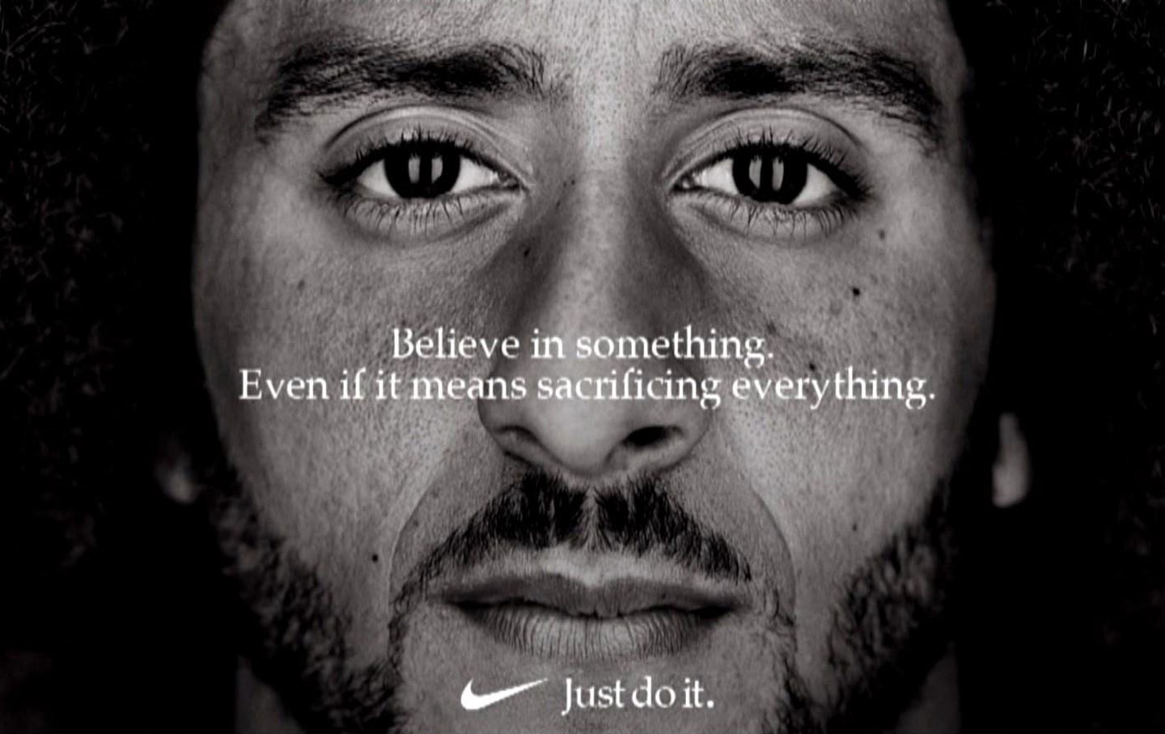
Nike Ad-Fall 2018

Slide 6
Speaker
S=Speaker:
who is giving the information?
Can be an individual speaking for him/herself or a person speaking on behalf of a group
what kind of person is he/she?
what does he/she value?

Slide 7
Speaker
S=Speaker:
Colin Kaepernick FOR Nike
Kaepernick first knelt during the national anthem as a player for the San Francisco 49ers in 2016—he was protesting injustices against minorities (like police brutality against unarmed Black men)
So, if he speaks for Nike, we then understand that Nike supports issues of social justice→equality

Slide 8
Occasion
O=Occasion:
addresses how time, place, culture, background prompt the writing of the piece
Larger Occasion – an environment of ideas, attitudes, and emotions that swirl around a broad issue – the bigger picture
Immediate Occasion – an event or situation that catches the writer’s attention and triggers a response—it’s the here and now that prompts the piece
essentially, it’s the context

Slide 9
Occasion
O=Occasion:
addresses how time, place, culture, background prompt the writing of the piece
Larger Occasion –
police brutality, Black Lives Matter
movement, attacks by President
Trump against athletes who protest
by kneeling during the anthem
Immediate Occasion –
start of 2018 NFL season, 30th
anniversary of “Just Do It”
essentially, it’s the context

Slide 10
Audience
A=Audience:
To whom is the piece directed?
Who may see it/read it anyway?

Slide 11
Audience
A=Audience:
Writer/speaker takes into account the audience’s experiences, expectations, feelings, and knowledge about the subject:
NFL fans
Kaepernick fans
People who disagree with kneeling
President Trump
The NFL itself (is it a rule to stand or not?)
Nike fans
*I read up on this; Nike says it is targeting 15-17 year olds. Note that research indicates younger people are more tolerant/inclusive.

Slide 12
Purpose
P=Purpose:
goal that the author wants to achieve
why’d he/she write it?

Slide 13
Purpose
P=Purpose:
goal that the author wants to achieve
why’d he/she write it?
To bring awareness about issues
that hinder people of color
To legitimize protest
To encourage activism
To sell shoes

Slide 14
Subject
S=Subject:
the focus or main topic of a piece

Slide 15
Subject
S=Subject:
the focus or main topic of a piece
Protest, activism, personal integrity, sacrifice

Slide 16
Tone
Tone:
an author’s opinion about/feelings toward the subject matter
*An author’s attitude refers to a judgment the author makes about the subject matter and is intellectual

Slide 17
Tone
Tone:
an author’s opinion about/feelings toward the subject matter
*An author’s attitude refers to a judgment the author makes about the subject matter and is intellectual:
Defiant
Encouraging
Proud

